Slide 1
IE260 Lecture 4: Linked List, Stack and Queue (Continued)
Il-Chul Moon
Department of Industrial and Systems Engineering
KAIST
icmoon@kaist.ac.kr

Slide 2
Short Recap

Slide 3
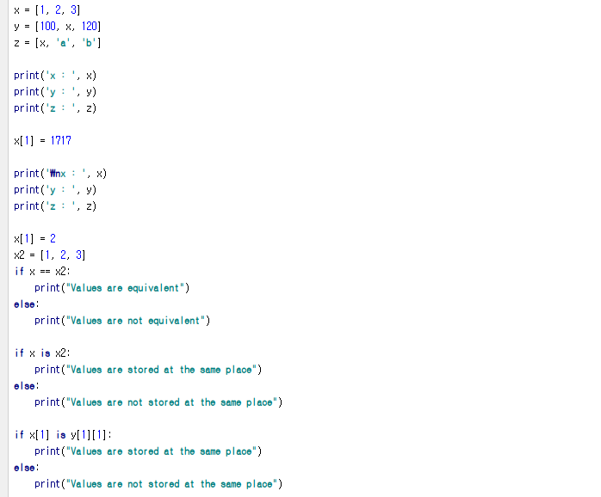
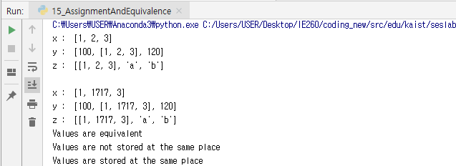

Detour: Assignment and Equivalence
y
1
x
3
reference
x
1
2
3
reference
z
One variable’s value is changed
But, you see three changes
Why this happened?
Because of references
x has two references from y and z
The values of y and z are determined by x, and x is changed
See the ripple effects
==
Checks the equivalence of two referenced values
is
Checks the equivalence of two referenced objects’ IDs
x
a
b
Notes:
We’ve seen this slide before.
We’ve already learned this in the lecture on Python.
The gist of the slide is a reference structure.
If you look here, you will find a well-defined list, x.
The list x is allocated to the 1st place of z and the 2nd place of y.
x can be stored in the 2nd place of y.
Y is designed to pinpoint where x is stored.
z does not just accept the value of x. It’s made to indicate the location of x.
That’s where the reference pointing to x is stored.
Therefore, when x is printed, it will print 1, 2, 3. When y is printed, it will print 100. Whatever pointed out x will call the value of x to be printed, which is 120.
Suppose the value of x is changed to another value.
Let’s assume x[1] will be replaced by 1717.
Now, the 2nd element of x is not 2 but 1717.
If we print out y, we will get [100, [1, 1717, 3], 120].
Although we did not modify anything in y, since y references x and x was changed, the print out of y will reflect the modified value of x. That’s how a reference structure works.
Now, how can we see if we’re dealing with a reference structure?
We have to be able to discern between a case when something is equal in value or a reference.
x2 stores these values: 1, 2, and 3.
Here, the values of x2 and x are identical.
Thus, the value is equivalent.
However, they are not stored in the same place.
In other words, we have to understand that having the same values differs from being stored in the same place.
The slide shows that if the value of the stored place is modified, the other values pointing to that same place will also be changed, accordingly.
To be able to implement a linked list, you need to understand this first.

Slide 4
Search Procedure in Singly Linked List
Again, let’s find ‘d’ and ‘c’ from the list
Just like an array, navigating from the first to the last until hit is the only way
No difference in the search pattern, though you cannot use index any further!
Your list implementation may include the index function, but it is not required in the linked list
node.objValue == ‘c’ → False: No hit!
node.objValue == ‘c’ → False: No hit!
node.objValue == ‘c’ → False: No hit!
node.objValue == ‘c’ → False: No hit!
node.objValue == ‘c’ → False: No hit!
head
‘a’
‘b’
‘d’
‘e’
‘f’
tail
node.objValue == ‘d’ → False: No hit!
node.objValue == ‘d’ → False: No hit!
node.objValue == ‘d’ → True: Hit!
After five retrievals,
we found that there will be no hit! (always N retrievals)
After three retrievals,
we found the hit! (maximum N retrievals)
Notes:
Now let’s carry out a search operation in a linked list, too.
Like before, we are going to locate “d” and “c” and assume that a linked list is defined as such.
Suppose that the head and tail are incorporated as member variables in the class called list. the next of the head to the previous of the tail are connected like this.
You’ll need to understand how to put data into the node.
However, we will start by assuming that they are inserted like this.
Just like an array, we have to navigate from the start to end by comparing every element.
As the comparison process is done in a row, it does not make any difference in terms of a search.
What’s different here is that we are no longer able to use an index.
Thus, we will use the next of a node instead of an index.
Originally, the node has its own object. A string called “a” is referenced with a member variable next so that the next node is referenced. As it is omitted, however, we will represent the next with an arrow and directly write down the objects.
Let’s first find out “c”.
First off, we will access a head to find its next.
We will first check if the next is the tail or not.
We’ve got to locate the head in the list, and then the next node of the head.
If the next node is the tail, stop the search with “break”.
If it is not a tail, find the object value of the node to see whether or not it is “d”.
If it is “d”, we can stop here. Otherwise, we have to find the next node of the node.
After completing the iteration in this manner, determine if it matches to “d”.
For instance, let’s find out “c”.
We found the next in the head, but it was not the tail.
As the object value of the node is not “c”, we will bring the next one.
This next is not the tail and its object value is other than “c”.
We keep on repeating the process until we find the object of the node is c or the tail node.
We eventually reach the tail and confirmed that “c” is not present inside.
We have to conduct five retrievals to confirm “c” is not in the list.
Thus, we have to conduct N retrievals to confirm its presence or absence.
Let’s say that we are searching for “d”.
First, it will bring the head before obtaining the next, which is not a tail.
As the object value of the next is not “d”, we need to get the next again.
Once again, the next is neither the tail nor d, so it will fetch the next again.
Although the next is not the tail but “d”, the process will terminate.
So, the process requires the maximum N for searches.
This is necessary to check out all the elements to find a specific element.
This is how a search is conducted in a linked list.

Slide 5
Insert Procedure in Singly Linked List
This is the moment that you see the power of a linked list
Last time, you need N retrievals to insert a value in the array list
This time, you need only three operations
With an assumption that you have a reference to the node, Node_{prev} that you want to put your new node next
First, you store a Node, or a Node_{next}, pointed by a reference from Node_{prev}’s nodeNext member variable
Second, you change a reference from Node_{prev}’s nodeNext to Node_{new}
Third, you change a reference from Node_{new}’s nodeNext to Node_{next}
Node_{new}
(3) Add this reference
(2) Update this reference
‘c’
(1) Store this node
head
‘a’
‘b’
‘d’
‘e’
‘f’
tail
Node_{prev}
Node_{next}
Over-written with a new reference to the new node
Notes:
Now we are going to explore how to insert data in a linked list.
You may notice that the insertion process differs from that of an array.
This shows the power of the linked list in the insertion process.
When we inserted an element in an array, we needed to make a new large array to place the value and copy it.
A linked list does not require a cumbersome process like this.
To do so, we just need three operations.
To that aim, let’s assume the following.
First, we have to identify which place to assign.
First, we should secure the location of NodePrev.
We will assume that we already know that we would like to place c after b.
We also know the cell where we want to insert the element in the array.
Suppose that we know where to place the element behind which node instead of the index.
Originally, NodePrev has a reference structure in a dot line.
After node b, we suppose that the node named “d” is referenced.
We can then recognize them as NodePrev and NodeNext right away.
For the next node to store data, we would have node_new that makes a new node by means of instantiation.
The new node to be inserted would already contain some values.
However, the next for the node_new is not yet determined.
We have to assign a proper value to the node_new.
Ideally, it should be corrected in a way so that the original node flow would pass through node_new.
First, we should store NodePrev and NodeNext, then override the value over the next of NodePrev.
We will set the next of the NodePrev to point to the newly introduced node_new.
When there is no “next” for NodePrev, we should make to produce the following result: nodePrev.next = NodeNew.
Then the next of the NodePrev will be the node_new. We should apply “NodeNew.next = NodeNext” to make the next of the currently empty node_new so that it’s NodeNext.
Thus, it will generate the reference structure where this next will be advanced to the other next.
As a result, the link will be disconnected in the linked list structure.
The connection is broken as the next of NodePrev that pointed to NodeNext is overridden by node_new.
Then, the b or the next of the next_prev will point to node_new, c, while the next of the node_new will indicate NodeNext, d.
In other words, the reference structure of the next node including a’s reference structure and d will not be changed.
The only change found includes the reference structures of b and c.
Therefore, it obviates the needs for modifying other nodes.
We can create a new space for the new value, just by modifying the structure of a reference.

Slide 6
Delete Procedure in Singly Linked List
This is the another moment that you see the power of a linked list
Last time, you need N retrievals to delete a value in the array list
This time, you need only three operations
With an assumption that you have a reference to the node, Node_{prev} that you want to remove the node next
First, you retrieve Node_{next} that is two steps next from Node_{prev}
Second, you change a reference from Node_{prev}’s nodeNext to Node_{next}
The node will be removed because there is no reference to Node_{remove}
(2) Update this reference
(1) Retrieve this node that is two step next
head
‘a’
‘b’
‘c’
‘d’
‘e’
‘f’
tail
Node_{prev}
Node_{remove}
Node_{next}
Over-written with a new reference to the next node of the removed one
Notes:
As we’ve figured out how to insert an element into a linked list, let’s look at how we can delete elements.
When we consider deletion in a linked list, we’ll see the power of using a linked list.
In the case of an array, we had to undergo the process of searching N times and copying and overriding elements that are not deleted.
The problem was the cumbersome process of handling and copying all the elements. I will show you that a linked list requires much fewer operations than using an array.
Now, let’s remove “d”.
Likewise, suppose that we know which element is to be eliminated.
NodePrev is already known.
While an insertion involves a new node instantiation for introducing a new element, this task does not require any instantiation.
Let’s say the next in NodePrev is NodeRemove. The name of the next of NodeRemove is NodeNext.
In this case, we should know about NodePrev, NodeRemove, and NodeNext in advance.
We will store NodeRemove = NodePrev.Next and NodeNext = NodePrev.Next.Next.
Previously, when we moved to the next in the NodePrev, we would get NodeRemove. Now, we have to sever the link since we have to remove NodeRemove.
However, we should not merely cut it off. It needs to point out what we want after the next—NodeNext.
The next of the NodePrev should not point to NodeRemove. It should point to NodeNext by means of overriding.
Overriding the value makes it no longer point to NodeRemove.
Previously, the flow went on like this. When the next from the head points to a, a to b with the next, b to c with the next, and c to d. But now, the next from the c indicates e, thereby eliminating d.
In fact, d references e, but there is nothing that points to d. Now that there is no way to find out d, this has the same effect of removing d.
While d is not removed from computer memory, Python will remove this inaccessible structure with a garbage collector.
Throughout the entire process, we’ve only dealt with three nodes: NodePrev, NodeRemove, and NodeNext.
We did not tinker with the nodes in the tail or head. The deletion process occurs in a quite restricted area.
Unlike an array, it is easy for a linked list to perform a “delete” operation.

Slide 7
Structure of Stack
Stacks are linear like linked lists
A variation of a singly linked list
Difference
Voluntarily giving up
Access to the middle in the linked list
Only accesses to the first instance in the list
The first instance in the list
= The top instance in the stack
An item is inserted or removed from the stack from one end called the “top” of the stack.
This mechanism is called Last-In-First-Out (LIFO).
Top Only Accessible
Cargo Object 1
Cargo Object 2
Cargo Object 3
Cargo Object 4
Cargo Object 5
Cargo Object 6
Notes:
The structure of a stack is like this.
Just like a linked list, a stack is linear.
In other words, it is connected in a linear way.
A stack can be seen as the modification of a singly linked list.
Other data structures allow taking data in and out of the linked list.
A stack, however, doesn’t work like this.
When a stack is intentionally defined, it means that it would not intervene with anything in the middle or the ends of the linked list.
It will put data in or out via the first node only.
Let’s call the 1st node the “top”.
The “top” is the only way to insert or delete the data.
The 1st instance is called the top of the stack.
Only insert and remove is called via top. This mechanism is called Last-In-First-Out or LIFO.
Let’s take a look at object 6 in the stack.
Obviously, object 6 should be entered through the top of this stack.
This object 6 was the first item to come.
The stack structure was completed by inserting from object 6 to object 1 in sequence.
The first item to come will leave last. So, in this case, object 1 at the top will leave the stack first.

Slide 8
Structure of Queue
Queues are linear like linked lists
A variation of a singly linked list
Difference
Voluntarily giving up
Access to the middle in the linked list == Same to the stacks
Only accesses to the first and the last instances in the list
The first instance in the list
= The front instance in the queue
The last instance in the list
= The rear instance in the queue
An item is inserted at the last
An item is removed at the front
This mechanism is called Fast-In-First-Out (FIFO)
Product 1
Product 2
Product 3
Product 4
Notes:
Let’s probe into the structure of a queue.
In some respects, a queue can be seen as the modified version of a singly linked list.
It differs from the singly linked list in that it abandons any access to the middle. It only allows entry and exit at the rear and front.
Entrance can only be done at the front, and exit can only be done at the rear.
As such, the first instance can only exit via the last instance.
This mechanism is called FIFO.
Product 1 gets in at this part, and it’s followed by others in a sequence.
As they come out in order, Product 2 only becomes available after the exit of Product 1.

Slide 9
Offline Class Plan

Slide 10

Production Planning Management
Excavator producers in Korea
Hyundai, Doosan…
Excavators are pretty expensive
Start production when orders come in
Any problem?
Orders always change
Cancelling
Changing the delivery date
Changing the specification
Changes get more difficult to handle when they are aggregated for a month-long production list
How to store and manage the production data?

Slide 11
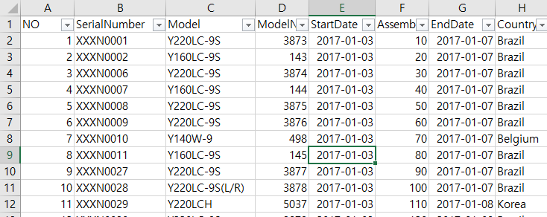
Dataset
You are given four production plans of excavator production
Plan on Dec 17, 2012
This week, we are going to use only this data
Plan on Dec 24, 2012
Plan on Jan 10, 2013
Plan on Jan 11, 2013
Four columns
No: just a number on the row
Serial Number: Unique identifier of an order
Model: Model name of the excavator
Model Number: The unique number of the product in the model line
Start Date: Production start date
Assembly Order: Production order
End Date: Production end date
Country: Order origination

Slide 12
Manufacturing Execution System
6개의 프로세서, 2개의 라인
Processor 1
Processor 2
Processor 3
Planned Product
Finished Product
Processor 4
Processor 5
Processor 6
지난주 : doubly linked list
프로세서에 처리해야 될
제품 리스트가 있음
1,2,3 은 stack
4,5,6 은 queue
Production list class
Stack class
Queue class
arriveProduct method 완성시키기
주어진 계획을 스택, 큐에 추가.
Processors have their own list of products to handle
Processor 1,2,3 follows the stack
Processor 4,5,6 follows the queue
Problem 1. Complete the production list class
Code addFirst, removeLast, removeFirst, and getSize
Problem 2. Complete the stack class
Problem 3. Complete the queue class
Problem 4. Complete the arriveProduct method of ManufacturingProcess class
Given “plan” should be added to the method of either stack or queue

Slide 13
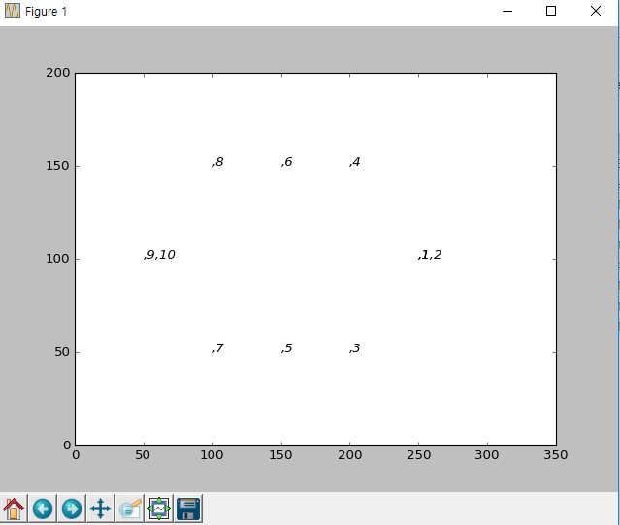
Execution Result
When you complete the codes, you are expected to see the below results.
Execute ‘run.py’
2개 라인. 대기라인 -> 완료

Slide 14
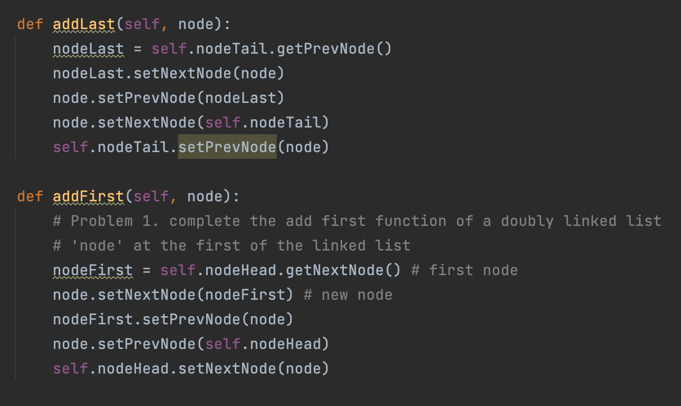
ProductionList class
지난주에 addLast
새로 추가할 node는 항상 tail node 의 이전노드
: nodeLast의 next node는 새로운 노드
-> 새로운 노드의 next node 는 tail node
-> 새로운 노드의 prev node 는 원래 last node
-> tail node의 prev node는 새로운 노드
같은 방법으로 첫번째 노드를 추가하는 addFirst
nodeFirst에 head 의 next 노드 저장
새로운 노드의 next 는 nodeFirst
nodeFirst의 이전노드는 새로운노드
새로운 노드의 이전노드는 head
Head의 next 노드는 새로운 노드

Slide 15
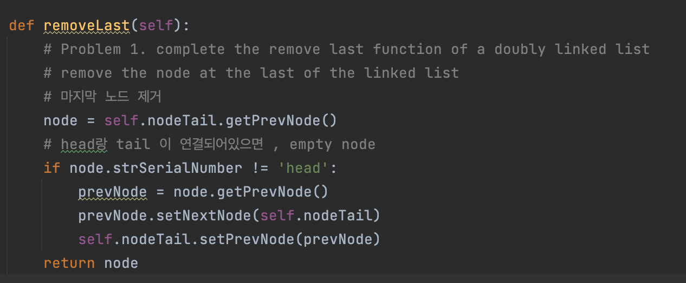
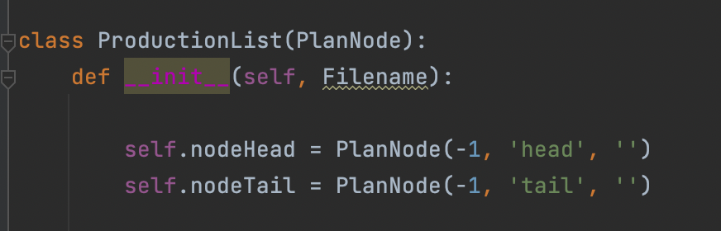
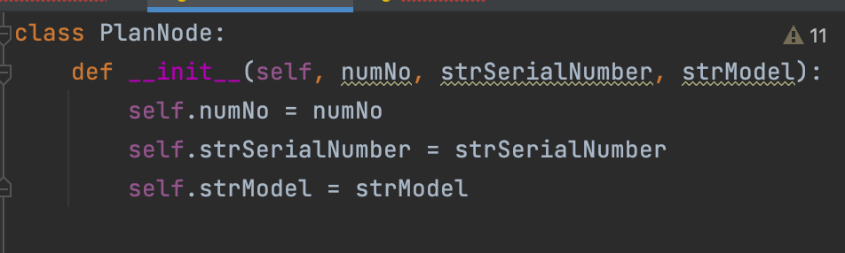
ProductionList class
head node 가 아닐 때를 조건으로 마지막 노드제거
Parameter node의 이전노드를 prevNode에 저장
이전노드의 다음 노드는 tail 노드
Tail node의 이전노드는 prevNode
PlanNode의 2번째 값이 head로 저장되어있음
strSerialNumber가 2번째 값임을 확인

Slide 16
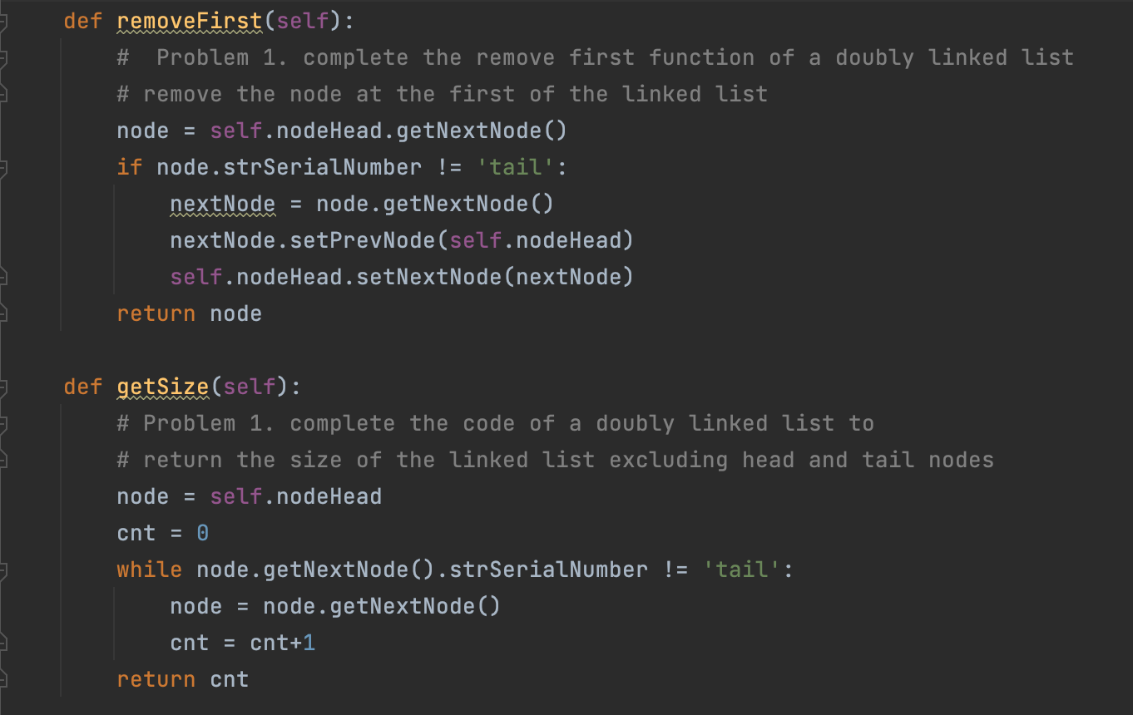
ProductionList class
removeLast 와 같은 방법으로 tail 노드가 아닐경우,
Node의 next를 nextNode 에 저장
NextNode의 이전노드는 head node
Head node의 next는 nextNode
Head 와 tail 을 제외한 linked list의 size 구하기
Headnode의 next 가 tail 이 아닐경우, 반복문 실행
첫번째 노드부터 1씩 더하면서 계산.

Slide 17
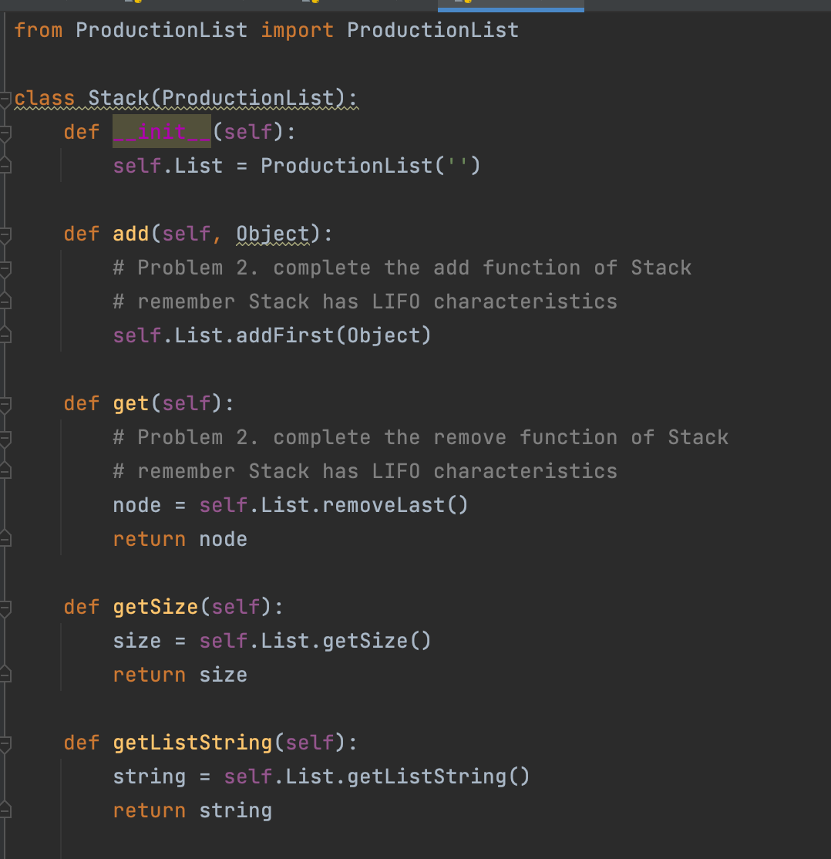
Stack class
Stack
LIFO라는 특징을 생각해서, add 할때는 addFirst method 를 사용
Get 할때는 removeLast method를 사용
- > 강의에서는 removeFirst..?

Slide 18
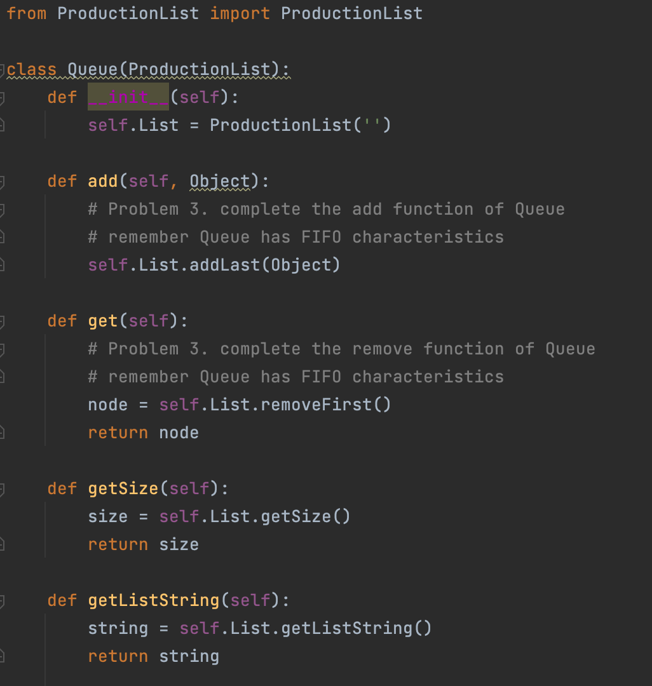
Queue class
Quque
FIFO라는 특징을 생각해서, add 할때는 addLast method 를 사용
Get 할때는 removeFirst method를 사용

Slide 19
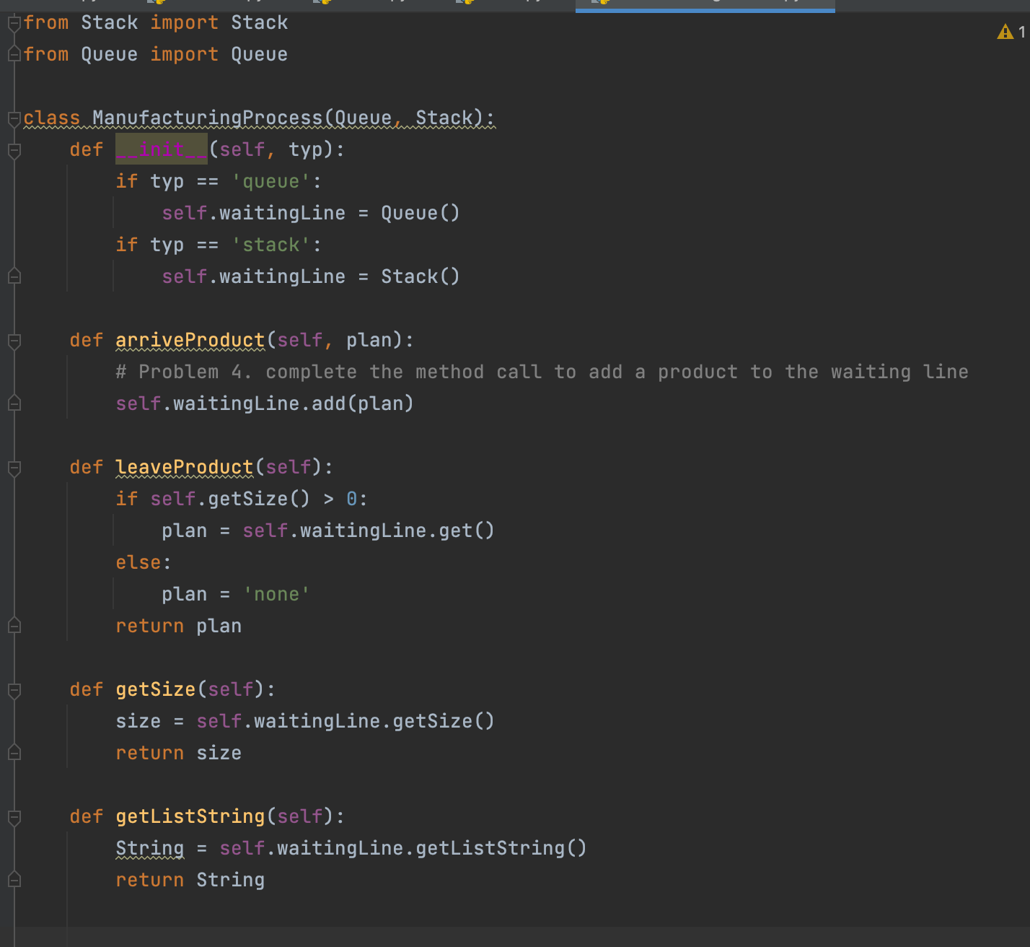
manufactoringprocess class
대기라인에 제품들을 add – stack 이나 queue 구조로

